Slide 1
Angle and Magnitude Criteria for Root Locus
Alpha Omega Engineering, Inc.
(www.aoengr.com)
February 2015
All rights reserved

Slide 2
Complex functions
Complex functions are like normal, real-valued functions except they can take complex inputs and produce complex results.
Real function: $y=f\left(x\right),$ where $x$ and $y$ are real numbers
Complex Function: $y=F\left(s\right),$ where $s$ and $y$ are complex numbers
Example: $y=F\left(s\right)=s+9$ is a complex function. We put in a complex number ($s$) and get out a complex result ($y$).
Admittedly, this is a pretty lame function. But it turns out that we don’t need to deal with functions much more complicated than this to establish what we want to here.

Slide 3
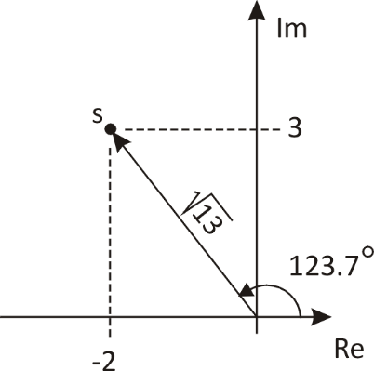
Polar form of a complex number
Complex numbers can be expressed in rectangular form: $s=−2+j∙3$
…or they can be expressed in polar form, using a magnitude and an angle.
$$M=\sqrt{{−2}^{2}+3^{2}}=\sqrt{13}$$
$$θ=arctan\left(3/{−2}\right)=123.7°$$

Slide 4
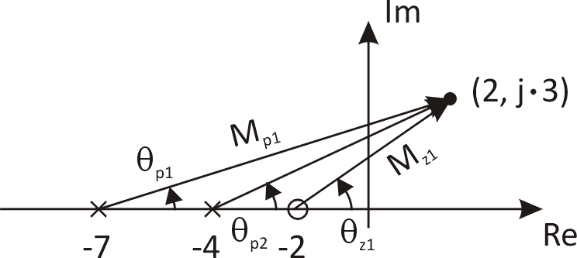
There is a graphical way to evaluate transfer functions
If complex functions have the form $F\left(s\right)=G\left(s\right)=\frac{K∙\left(s+z_{1}\right)…\left(s+z_{m}\right)}{\left(s+p_{1}\right)…\left(s+p_{n}\right)}$ , there is a special graphical way to evaluate them. Note that this format is the normal format for the transfer functions used in control theory (a gain in the numerator, zeros in the numerator, and poles in the denominator).
The procedure, by example: Take $F\left(s\right)=\frac{41.7∙(s+2)}{(s+4)∙(s+7)}$ evaluated at $s=2+j∙3$
Plot the poles and the zeros on the complex plane and then draw vectors from each one to the point where we want to evaluate the function.
To keep track of everything, label the magnitudes and the angles as shown, relating each to the pole or zero from which it leads.

Slide 5
Evaluating complex function graphically
The result is found in magnitude/Angle format. It is
$magnitude(F\left(s\right))=K\frac{\prod{M_{z}}}{\prod{M_{p}}}$ and $angle\left(F\left(s\right)\right)=\sum{θ_{z}}−\sum{θ_{p}}$
Thus, for the example above:
 | M | θ
z1 | $$\sqrt{4^{2}+3^{2}}=\sqrt{25}=5$$ | $$\arctan\left(3/4\right)=36.9°$$
p1 | $$\sqrt{9^{2}+3^{2}}=\sqrt{90}=3\sqrt{10}$$ | $$\arctan\left(3/9\right)=18.4°$$
p2 | $$\sqrt{6^{2}+3^{2}}=\sqrt{45}=3\sqrt{5}$$ | $$\arctan\left(3/6\right)=26.6°$$
Result:

Slide 6
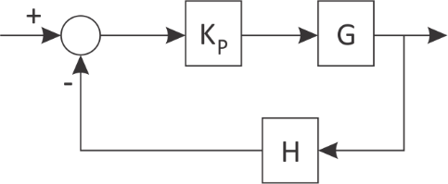
What does this have to do with a control loop?
Take a standard control loop with a P-only controller:
$$G_{CL}=\frac{K_{P}∙G}{1+K_{P}∙G∙H}$$
The characteristic equation is $1+K_{P}∙G∙H=0$ or $K_{P}∙G∙H=−1=1∠±180°$
This is a very important result, and here is why: If a complex number satisfies the characteristic equation, then it is a root of the characteristic equation, and that makes it a closed-loop pole. That means it is on the root locus.
Thus one could find the root locus by evaluating every point in the complex plane using the graphical method demonstrated earlier. Of course, this is impractical, as it would take a very long time. Still this methodology and this result are useful for asking whether a certain point is on the root locus.

Slide 7
Some observations about the foregoing…
The function $K_{P}∙G∙H$ is the open-loop transfer function, not the closed-loop transfer function.
The foregoing establishes two conditions about the open-loop transfer function for a point on the root locus:
The magnitude criterion: $\left|K_{P}∙G∙H\right|=1$
The angle criterion: ∠$K_{P}∙G∙H=±180°$
If the open-loop transfer function does not meet these two criteria evaluated at a particular $s$, then that point in the complex plane is not on the root locus
It is easy to meet the magnitude criterion: Just set $K_{P}=\frac{1}{\left|G∙H\right|}$
There is no trick like this for the angle criterion. If a point does not meet the angle criterion, it simply is not on the root locus.

Slide 8
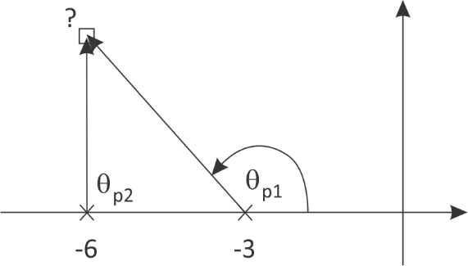
Example: $G_{OL}=\frac{K_{p}}{(s+3)(s+6)}$
Determine whether or not the point $s=−6+j3$ is on the root locus.
From the graph it can be seen that $θ_{p2}=90°$ and $θ_{p1}=135°$ (you always measure the angles from the positive, real axis).
Thus ∠$K_{P}∙G∙H≠±180°$. The point $s=−6+j3$ does not meet the angle criterion and, thus, does not satisfy the characteristic equation and, thus, is not a closed-loop pole, and, thus, is not on the root locus, since the root locus is the location of the closed-loop poles as they move when Kp varies from 0 to ∞.

Slide 9
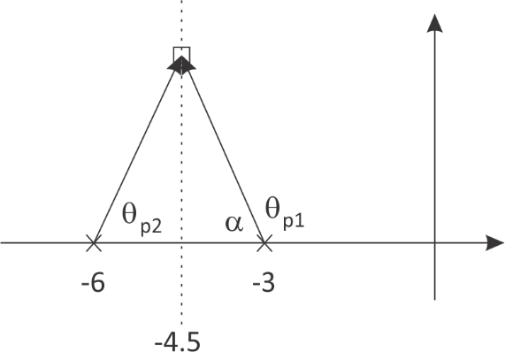
Result from this important case:
It can also be determined what will happen in this important case, where the open-loop transfer function has two real poles and no zeros.
It is only on a vertical line half-way between the two poles that the angle criterion will be met. For that case, $α+θ_{p1}=180°$. With points on the vertical line at -4.5, the two vectors from p1 and p2 form an isosoles triangle. Thus $θ_{p2}=α$, and the angle criterion is satisfied.
Then for all points on this line, KP can be set to 1/|G·H| to meet the magnitude criterion.

Slide 10
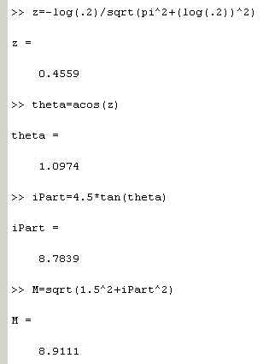
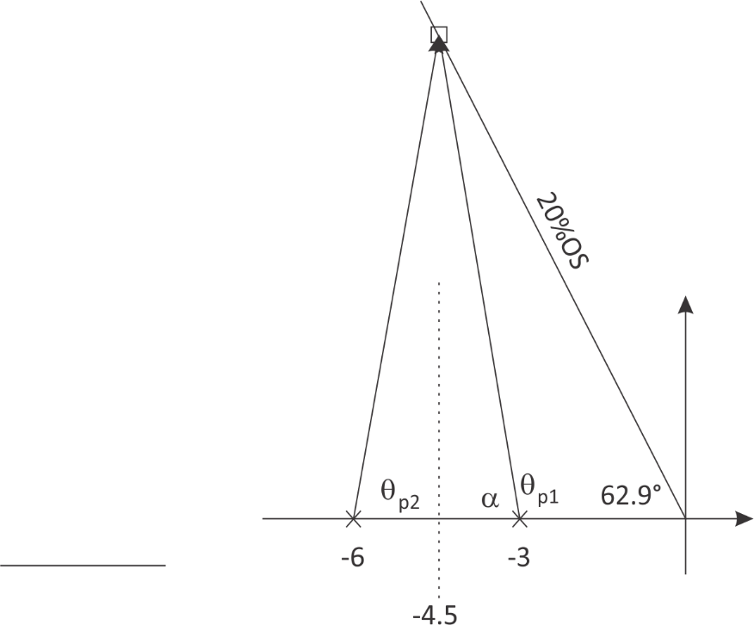
Another example
For this same system, what is the limit on KP to limit the %OS to 20%?
Here’s a solution using Matlab:
This is where we want closed-loop poles.
Use ζ/%OS relationship to get ζ.
Use ζ to get θ on the plot of the complex plane.
Matlab’s trig functions work with radians. θ = 62.9°.
Matlab’s trig functions work with radians. θ = 62.9°.
Now find the height up to the CL pole on the 20%OS line.
The magnitudes of the two vectors from p1 and p2 are the same. Find this magnitude.

Slide 11
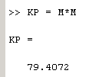
For 20%OS, need KP = 79.4
$$M_{K_{P}GH}=\frac{K_{P}}{\prod{M_{p}}}=1$$
$$K_{P}=\prod{M_{p}}=M∗M$$

